Slide 1

Why computing molecules?
Selected applications on (bio)molecular systems
Vasile Chiș
Babeș-Bolyai University
Faculty of Physics
Department of Biomolecular Physics
Kogălniceanu 1
RO-400084 Cluj-Napoca
Chemnitz 2015

Slide 2

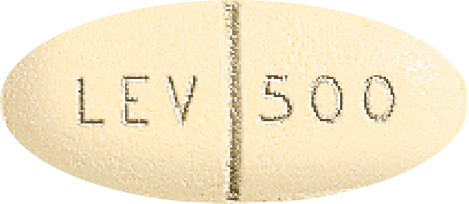
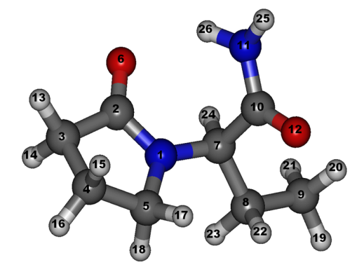
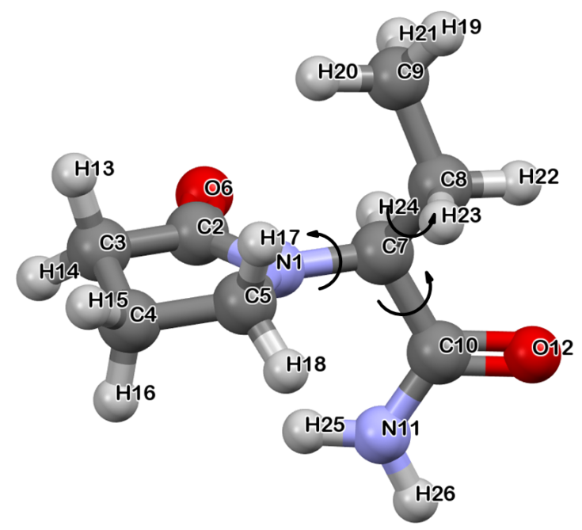
Conformation landscape of LEV
Vasile Chiș
Why Computing Molecules?
Levetiracetam (LEV)
(S)-2-(2-oxopyrrolidin-1-yl) butanamide
biologically active S-enantiomer of etiracetam.
a second-generation antiepileptic drug (AED)
acts differently with respect to other common AEDs
barely protein-bound
minimally metabolized
minor drug-drug interactions.
Conformational landscapes
crucial importance for modeling the drug-receptor interactions
essential for describing reliably the spectroscopic properties of APIs
understanding their conformational polymorphism and crystal growth processes.

Slide 3
Conformation landscape of LEV
Vasile Chiș
Why Computing Molecules?
Computational methodology
Molecular mechanics (MM) for the initial search (Tinker program, MMFF94 force field)
  Starting geometries:
    solid-state structures reported for LEV
    LEV's geometries found in the anhydrous polymorphic forms and hydrate phase of etiracetam.
The identified stable conformers have been further optimized in vacuum, water and ethanol
  DFT quantum chemical calculations
    B3LYP – xc functional
    Basis sets: 6-31G(d) = BS1 and 6-31+G(2d,2p) = BS2
  Frequency calculations to confirm that all the optimized geometries correspond to minima on the potential energy surface.

Slide 4
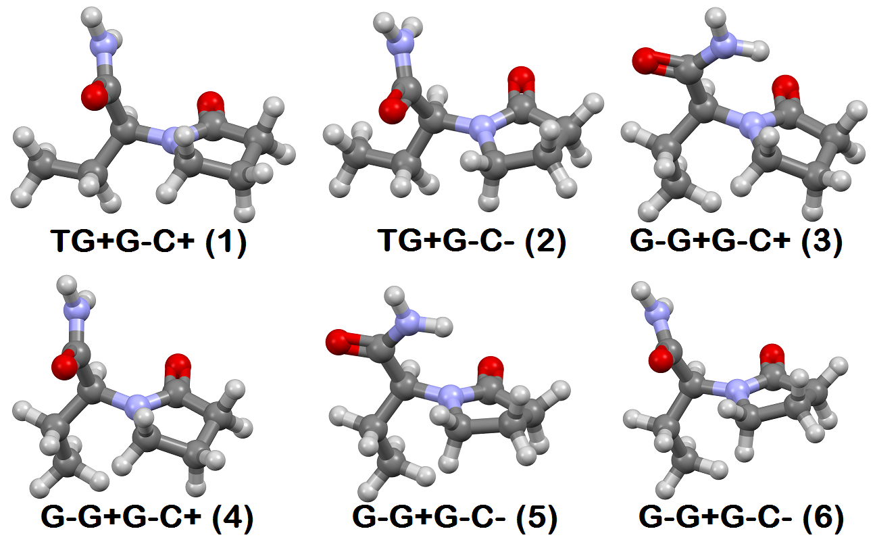
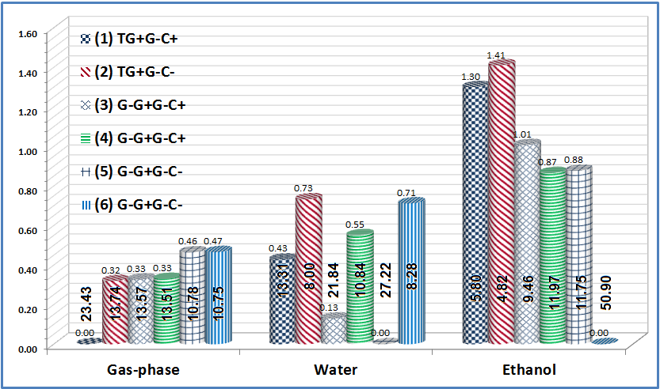
Conformation landscape of LEV
Vasile Chiș
Why Computing Molecules?
The first six most stable conformers of LEV, in water, at B3LYP/6-31+G(2d,2p) level of theory

Slide 5
Conformation landscape of LEV
Vasile Chiș
Why Computing Molecules?
Table 1. B3LYP/BS2 calculated dihedral angles (degrees) characterizing the levetiracetam conformers in gas-phase, water and ethanol (first, second and third entry, respectively).
Experimental data for the known solid state structures of LEV are included for comparison purposes
Conformer | C9-C8-C7-N1 | N11-C10-C7-N1 | C8-C7-N1-C5 | C3-C4-C5-N1
TG+G-C+ (1) | -167.1 -170.9 -170.3 | 79.2 103.6 100.6 | -45.6 -57.3 -56.0 | 26.6 25.9 26.0
TG+G-C- (2) | -168.9 -172.3 -172.7 | 79.1 104.9 105.4 | -36.0 -50.3 -50.8 | -21.8 -25.5 -26.2
G-G+G-C+ (3) | -61.3 -59.0 -59.0 | 77.5 22.3 23.5 | -47.7 -55.7 -56.3 | 27.0 22.2 22.3
G-G+G-C+ (4) | -61.4 -59.5 -59.9 | 77.5 107.2 91.6 | -47.6 -56.0 -55.2 | 27.0 26.2 25.7
G-G+G-C- (5) | -65.2 -62.0 -62.0 | 77.0 18.7 19.4 | -40.9 -50.9 -51.3 | -20.5 -26.7 -26.9
G-G+G-C- (6) | -65.2 -63.0 -63.4 | 77.0 115.0 111.1 | -40.8 -49.0 -50.0 | -20.6 -25.6 -25.7
Experimental data
LEV [Son03] | -54.46 | 13.65 | -58.23 | 12.92
Etiracetam FI [Her13] | -58.15 | 33.81 | -62.47 | -25.13
Etiracetam FII [Her13] | -56.06 | 39.22 | -65.54 | -13.95
Etiracetam Hydrate [Her13] | -57.15 | 20.47 | -53.78 | -21.54

Slide 6
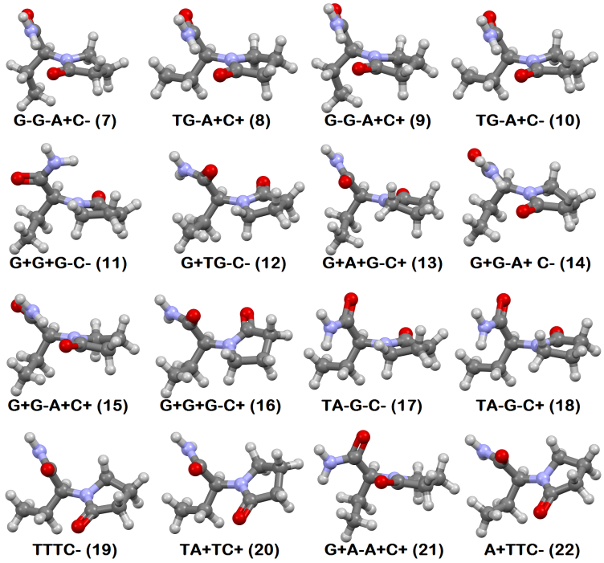
Conformation landscape of LEV
Vasile Chiș
Why Computing Molecules?
Conformer | Gas |  | Water |  | Ethanol
 | ∆G (kcal mol⁻¹) | Population (%) | ∆G (kcal mol⁻¹) | Population (%) | ∆G (kcal mol⁻¹) | Population (%)
G-G-A+C- (7) | 0.96 | 4.73 | 1.32 | 3.01 | 2.08 | 1.58
TG-A+C+ (8) | 1.15 | 3.44 | 1.58 | 1.95 | 2.30 | 1.08
G-G-A+C+ (9) | 1.23 | 3.01 | 1.51 | 2.18 | 2.23 | 1.23
TG-A+C- (10) | 1.25 | 2.89 | 1.78 | 1.39 | 2.52 | 0.75
G+G+G-C- (11) | 3.89 | 0.04 | 3.53 | 0.07 | 4.11 | 0.05
G+TG-C- (12) | 4.00 | 0.03 | 2.69 | 0.31 | 3.52 | 0.14
G+A+G-C+ (13) | 4.12 | 0.02 | 3.63 | 0.06 | 5.36 | 0.01
G+G-A+C- (14) | 4.31 | 0.02 | 4.78 | 0.01 | 5.33 | 0.01
G+G-A+C+ (15) | 4.39 | 0.02 | 4.72 | 0.01 | 5.57 | 0.00
G+G+G-C+ (16) | 4.48 | 0.01 | 3.50 | 0.08 | 4.51 | 0.03
TA-G-C- (17) | 4.94 | 0.01 | 2.30 | 0.59 | 3.37 | 0.18
TA-G-C+ (18) | 5.17 | 0.00 | 2.12 | 0.78 | 3.16 | 0.26
TTTC- (19) | 6.73 | 0.00 | 3.93 | 0.04 | 4.96 | 0.02
TA+TC+ (20) | 7.60 | 0.00 | 4.16 | 0.03 | 5.36 | 0.01
G+A-A+C+ (21) | 8.22 | 0.00 | 5.84 | 0.00 | 6.91 | 0.00
A+TTC- (22) | 8.50 | 0.00 | 6.75 | 0.00 | 7.96 | 0.00

Slide 7
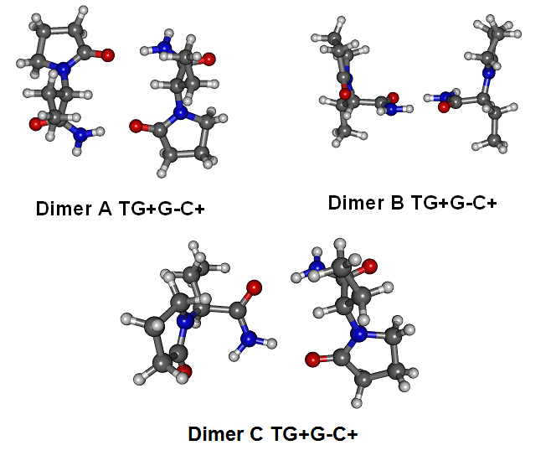
Conformation landscape of LEV
Vasile Chiș
Why Computing Molecules?
LEV dimers

Slide 8
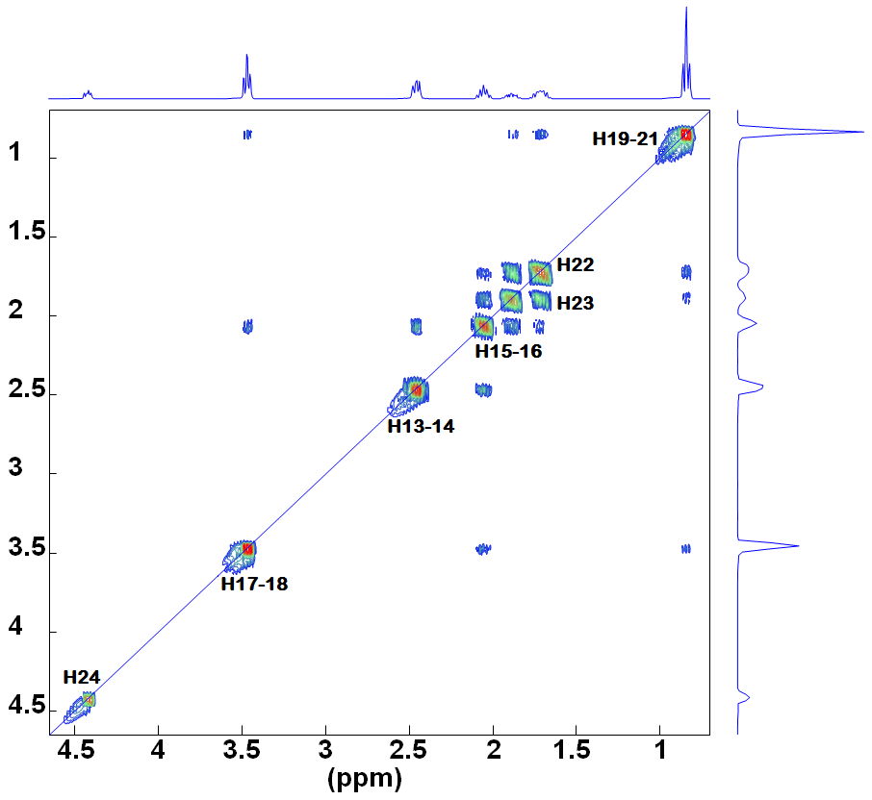
NMR spectra
Vasile Chiș
Why Computing Molecules?
 | Exp. | Theoretical data
 |  | Monomer | Dimer
MAE |  | 0.49 | 0.54
C2 | 178.53 | 178.09 | 178.51
C10 | 174.27 | 174.11 | 174.07
C7 | 55.91 | 57.18 | 55.58
C5 | 44.04 | 44.90 | 44.82
C3 | 30.40 | 30.51 | 30.53
C8 | 20.89 | 21.87 | 22.39
C4 | 17.13 | 16.90 | 17.61
C9 | 9.43 | 7.04 | 7.08
H26 | 7.61, s | 7.63 | 8.57
H25 | 7.10, s | 6.61 | 5.95
H24 | 4.49, 1H dd | 4.87 | 4.76
H17, H18 | 3.49, 2H, t | 3.78 | 3.40
H13, H14 | 2.48, 2H, t | 2.29 | 2.30
H15, H16 | 2.08, 2H, q | 1.93 | 2.03
H23 | 1.90, 1H, m | 1.83 | 2.32
H22 | 1.72, 1H, m | 1.64 | 1.31
H19-21 | 0.86, 3H, t | 0.60 | 1.03
Identify the most stable conformers
Calculate their relative energies and Boltzmann populations
Calculate the Boltzmann averaged screening tensors
Substract the calculated ST from those of the TMS or derive the scaling equation
Report the calculated chemical shifts

Slide 9
Algorithm for NMR spectra calculation in 5 steps
Vasile Chiș
Why Computing Molecules?
Step 1: Optimization and Frequency calculations for the molecule of interest
%chk=LEV_OFR.chk
%mem=32GB
%nprocshared=32
#P Opt Freq(Raman,intmodes) b3lyp/6-31+g(2d,2p) scrf=(pcm, solvent=water)
LEV OFR water
0 1
C 0.00 0.00 0.00
.....
Starting geometry
.....
Step 2: NMR spectrum calculation for the molecule of interest
%chk=LEV_OFR.chk
%mem=32GB
%nprocshared=32
#P NMR(Giao) Iop33(10=1) b3lyp/6-31+g(2d,2p) scrf=(pcm, solvent=water)
LEV NMR water
0 1
C ...................
.....
Optimized geometry in step 1
.....

Slide 10
NMR spectra
Vasile Chiș
Why Computing Molecules?
Step 3: Optimization and Frequency calculations of tetramethylsimale (TMS)
%chk=LEV_OFR.chk
%mem=32GB
%nprocshared=32
#P Opt Freq(Raman,intmodes) b3lyp/6-31+g(2d,2p) scrf=(pcm, solvent=water)
TMS OFR water
0 1
C 0.00 0.00 0.00
.....
Starting geometry of TMS
.....
Step 4: NMR spectrum calculation of TMS
%chk=LEV_OFR.chk
%mem=32GB
%nprocshared=32
#P NMR(Giao) Iop33(10=1) b3lyp/6-31+g(2d,2p) scrf=(pcm, solvent=water)
TMS NMR water
0 1
C ..................
.....
Optimized geometry in step 3
.....

Slide 11
NMR spectra
Vasile Chiș
Why Computing Molecules?
Step 5: Obtain the calculated chemical shifts
Molecule of interest
SCF GIAO Magnetic shielding tensor (ppm):
1 C Isotropic = 134.3930 Anisotropy = 20.0251
XX= 140.4126 YX= -3.9631 ZX= 0.9807
XY= 4.5824 YY= 139.0220 ZY= 15.4056
XZ= 3.0687 YZ= 12.9967 ZZ= 123.7442
TMS
2 C Isotropic = 192.6564 Anisotropy = 8.3873
XX= 192.6564 YX= 2.7958 ZX= 2.7958
XY= 2.7958 YY= 192.6564 ZY= 2.7958
XZ= 2.7958 YZ= 2.7958 ZZ= 192.6564
δ(ppm)=192.6564-134.3930 = 58.26 ppm
..... do the same for all nuclei of interest......
If more conformers are analyzed, do the same for each nucleus of each conformer

Slide 12
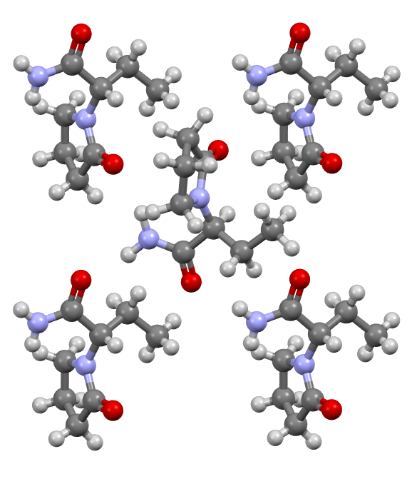
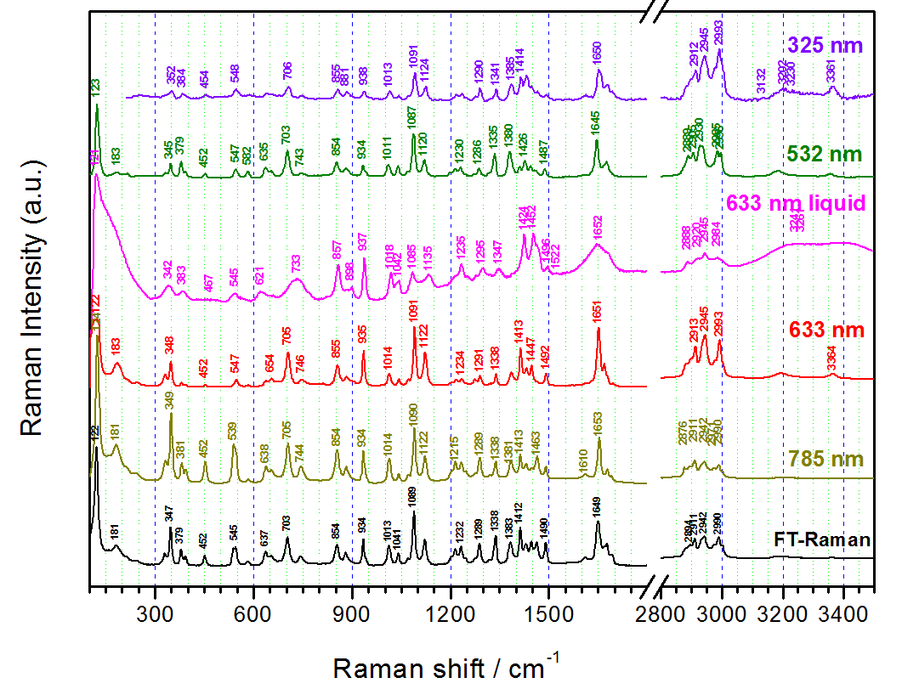
Vibrational spectra
Vasile Chiș
Why Computing Molecules?
LEV
br
br
br
br
= (3)
br – amide bands
=> HB through NH₂
1452, 1424, 1042, 1018, 937 and 857 cm⁻¹
- do not change
- Opy and/or Et bands
br
733 = coalescence of the "solid state" doublet observed at 705 and 746 cm⁻¹.
Calculated on solvated monomer: 734 cm⁻¹

Slide 13

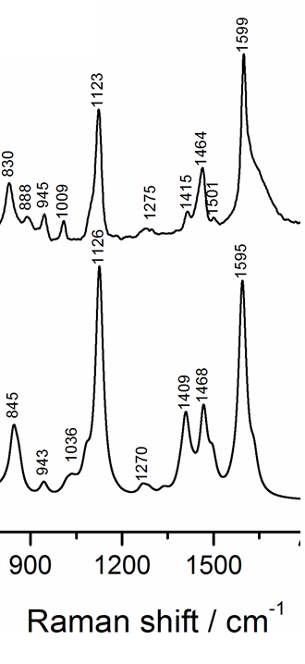
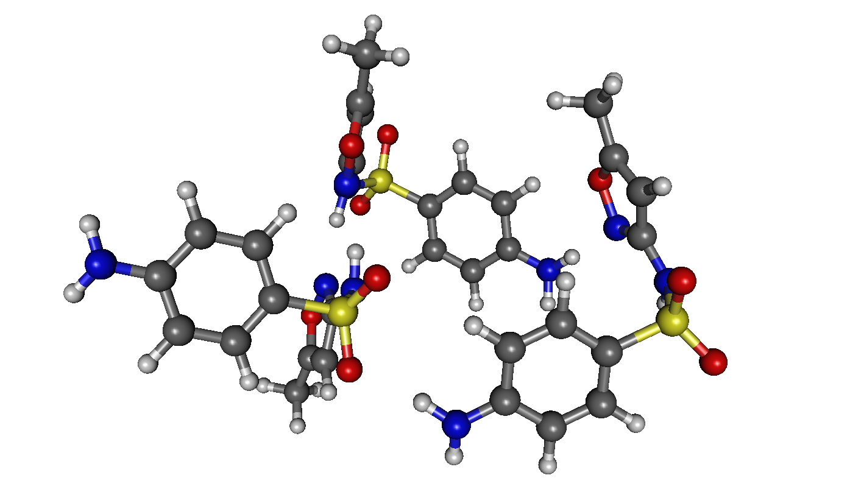
Vibrational spectra
Vasile Chiș
Why Computing Molecules?
Sulfamethoxazole (SMX)
Experimental
IR
Raman
Calculated
A. Ungurean, M. Oltean, L. David, N. Leopold, J. P. Prates Ramalho, V. Chiş,
J. Mol. Struct., 2014, 1073, 71-76

Slide 14
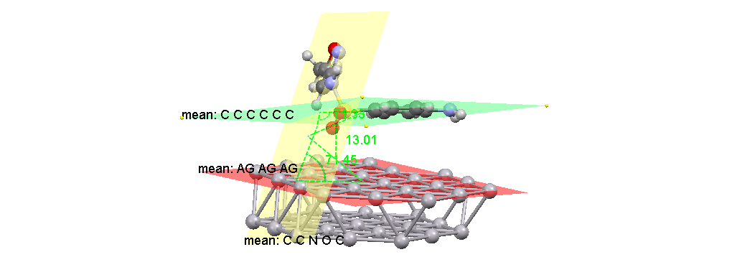
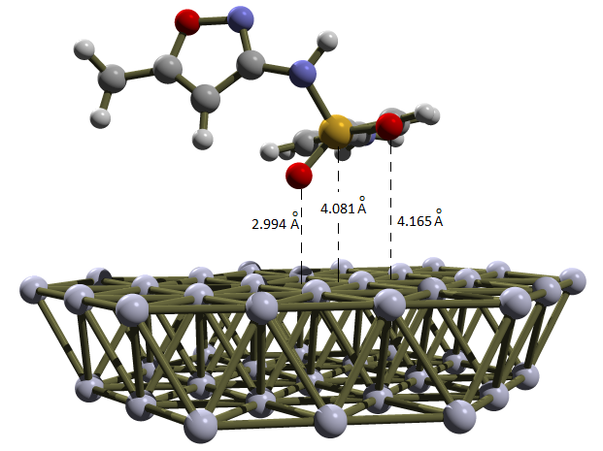
Geometries
Vasile Chiș
Why Computing Molecules?
Sulfamethoxazole (SMX)
SMX@Ag(111)
Ungurean, M. Oltean, L. David, N. Leopold, J. P. Prates Ramalho, V. Chiş,
J. Mol. Struct., 2014, 1073, 71-76

Slide 15
Recommendations for vibrational spectra calculations
Vasile Chiș
Why Computing Molecules?
Choose the right model: monomer, dimer, cluster
Choose the level of theory (method + basis set)
Optimize the geometry
Calculate the normal modes
Check for negative frequencies. If found, alter the geometry along the corresponding normal mode and goto step 3; else goto 6.
Scale the wave-numbers; use appropriate scaling factors
  Scaling factors: literature, CCCBDB site, etc.
%chk=LEV_OFR.chk
%mem=32GB
%nprocshared=32
#P Opt Freq(Raman,intmodes) b3lyp/6-31+g(2d,2p) scrf=(pcm, solvent=water)
LEV OFR water
0 1
C 0.00 0.00 0.00
.....
Starting geometry
.....

Slide 16
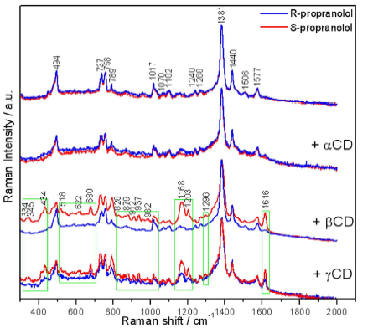
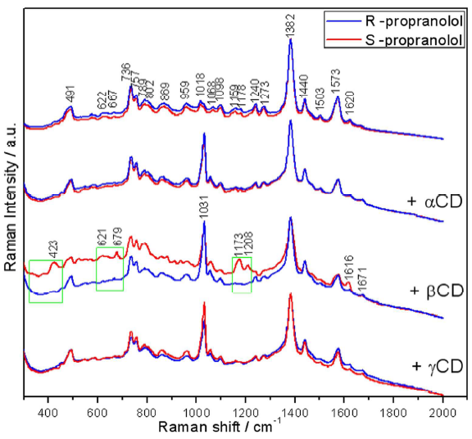
DFT-D
Vasile Chiș
Modeling non-covalent interactions and molecular excited states by DFT methods
CD-propranolol inclusion complexes
SERS on silver colloid
(785 nm)
SERS on gold colloid
(785 nm)
Rares Stiufiuc, Cristian Iacovita, Gabriela Stiufiuc, Ede Bodoki, Vasile Chiş, Constantin M. Lucaciu
Phys. Chem. Chem. Phys., 2015, 17, 1281-1289.

Slide 17
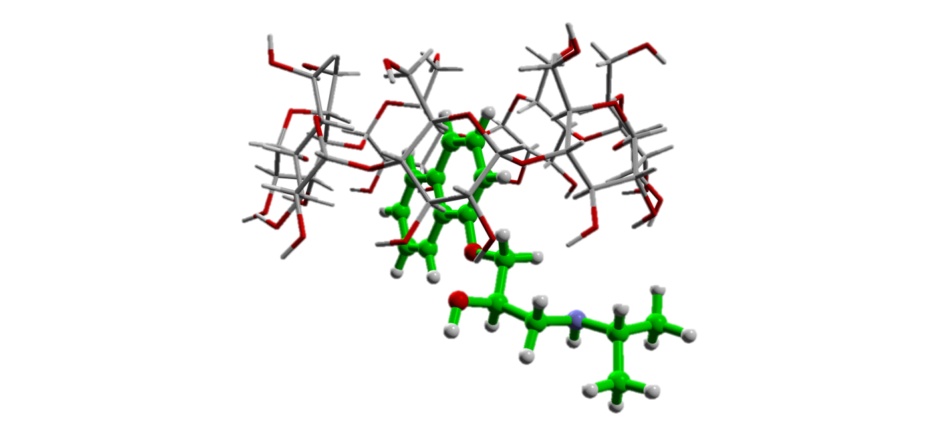
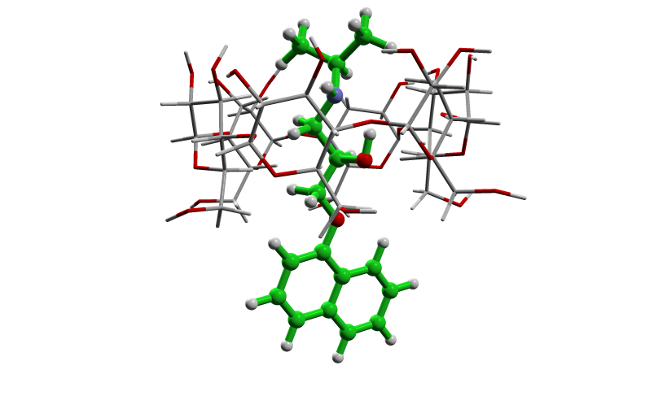
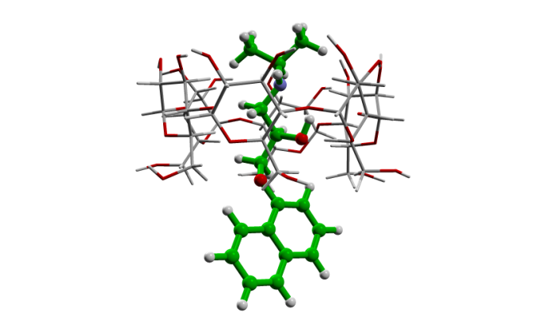
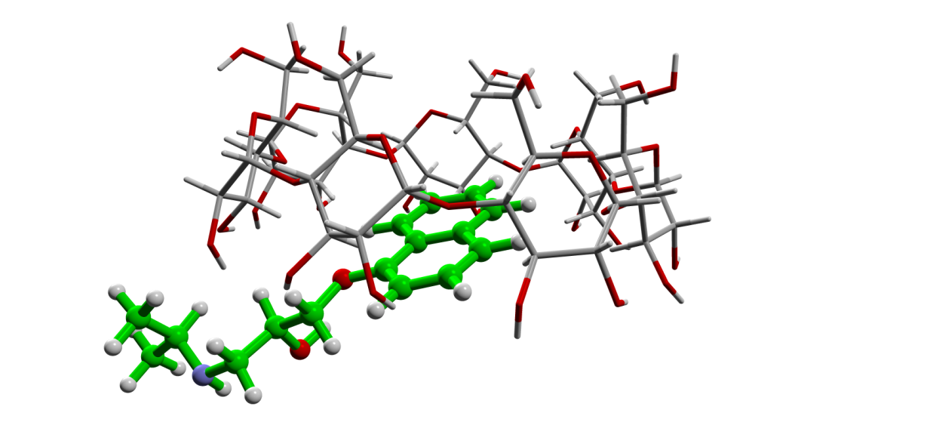
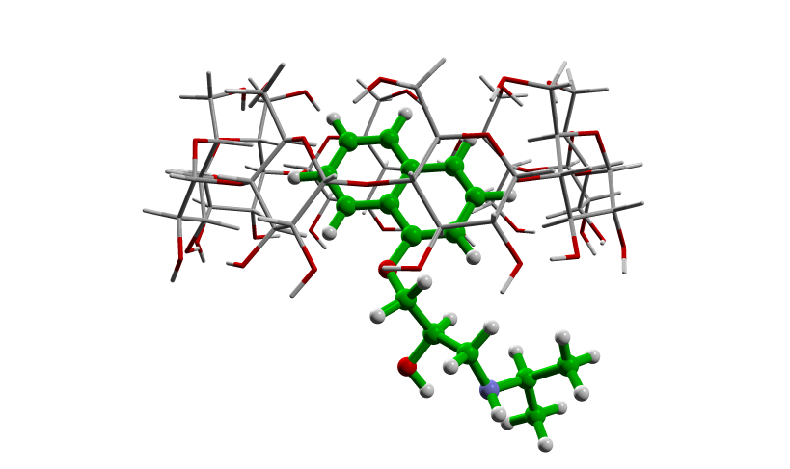
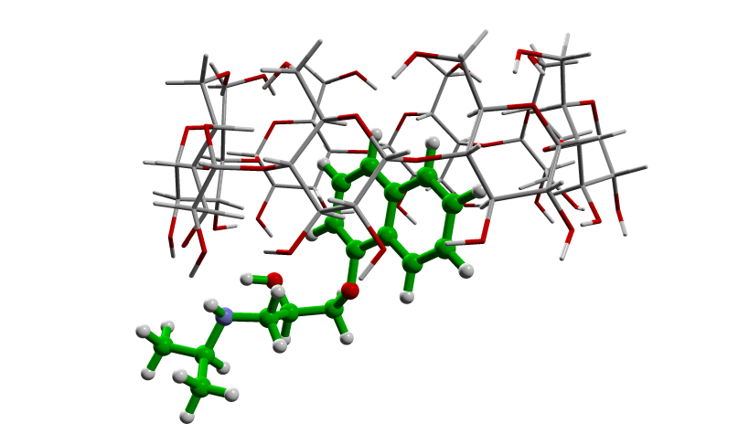
DFT-D
Vasile Chiș
Modeling non-covalent interactions and molecular excited states by DFT methods
CD-propranolol inclusion complexes
β-CD-R
α-CD-R
α-CD-S
β-CD-S
γ-CD-R
γ-CD-S
Rares Stiufiuc, Cristian Iacovita, Gabriela Stiufiuc, Ede Bodoki, Vasile Chiş, Constantin M. Lucaciu
Phys. Chem. Chem. Phys., 2015, 17, 1281-1289.

Slide 18
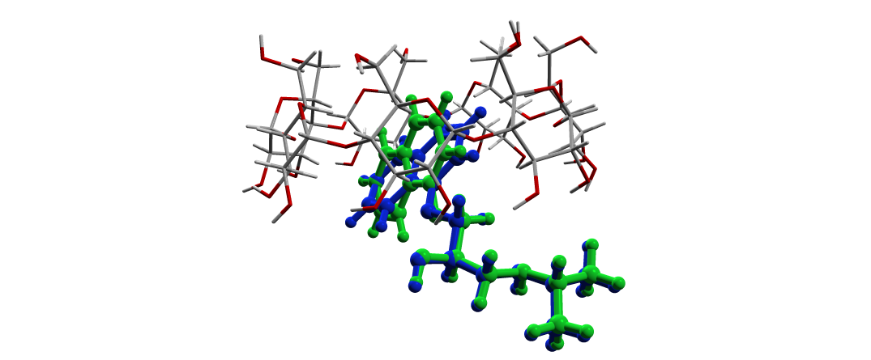
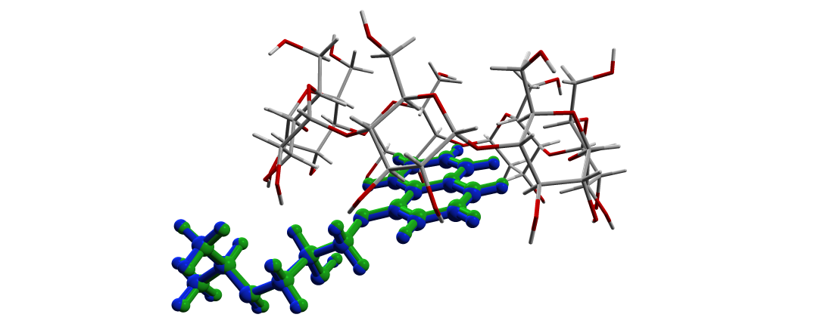
DFT-D
Vasile Chiș
Modeling non-covalent interactions and molecular excited states by DFT methods
CD-propranolol inclusion complexes
B3LYP-D/6-31G(d) (green color) and B97-D/6-31G(d) (blue color) optimized geometries of R- (left) and S- propranolol (right) inside the β-CD cavity.
Geometrical parameter | βCD-R | βCD-S
distance[X_{CD}-C*] | 5.829 | 6.522
angle[P_{mean}(CD),P_{mean}(naphthyl)] | 76.8 | 27.1
distance[X_{naphthyl}-P_{mean}(CD)] | 1.467 | 1.587
C*- chiral carbon of the enantiomer, X_{CD}-centroid defined by the oxygen atoms linking the glucopyranose units, P_{mean}(CD)-mean plane defined by the oxygen atoms linking the glucopyranose units, P_{mean}(naphthyl)-average plane of the naphthyl group, X_{naphthyl}-centroid of the naphthyl group
Rares Stiufiuc, Cristian Iacovita, Gabriela Stiufiuc, Ede Bodoki, Vasile Chiş, Constantin M. Lucaciu
Phys. Chem. Chem. Phys., 2015, 17, 1281-1289.

Slide 19
DFT-D
Vasile Chiș
Modeling non-covalent interactions and molecular excited states by DFT methods
CD-propranolol inclusion complexes
Binding energies of the inclusion complexes calculated B3LYP-D/6-31G(d) and B97-D/6-31G(d)
 | B3LYP-D | B97-D
β-CD-R | -67.6 | -36.2
β-CD-S | -64.7 | -32.8
Rares Stiufiuc, Cristian Iacovita, Gabriela Stiufiuc, Ede Bodoki, Vasile Chiş, Constantin M. Lucaciu
Phys. Chem. Chem. Phys., 2015, 17, 1281-1289.

Slide 20
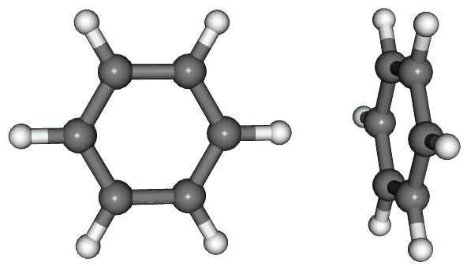
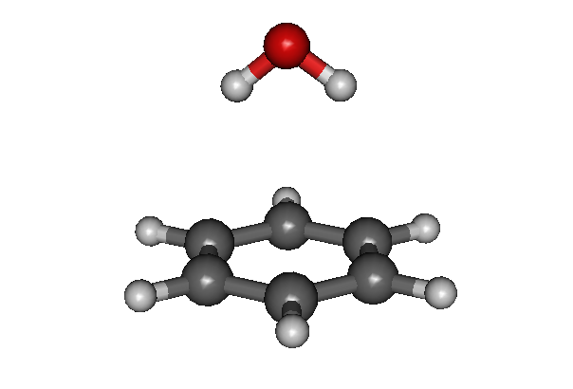
DFT-DCP
Vasile Chiș
Why Computing Molecules?
Benzene dimer and Benzene-water complex
Benzene dimer
T-shaped benzene | Interaction energy (kcal/mol) | Equilibrium distance (Å)
Experimental * | -2.40 | 4.960
PBE0-DCP/ 6-31+G(d,p) | -2.35 | 5.000
*E. Arunan, H. Gutowsky, J. Chem. Phys. 1993, 98, 4294;
J.R. Grover, E.A. Walters, E.T. Hui, J. Phys. Chem. 1987, 91, 3233.
Water - Benzene complex
Water-benzene | Interaction energy (kcal/mol) | Equilibrium distance (Å)
Experimental* | -3.25 ÷ -3.40 | 3.32 ÷ -3.35
PBE0-DCP
quantitative results for De and Re
no “structural dependence”
CCSD(T)/CBS vdW-DF** | -3.34 ÷ -3.80 | 3.44
PBE0-DCP/ 6-31+G(d,p) | -3.72 | 3.340
*Y. Zhao, O. Tishchenko, D.G. Truhlar, J. Phys. Chem. B, 2005, 109, 19046.
** S. Li, V.R. Cooper, T. Thonhauser, A. Puzder, D.C. Langreth, J. Phys. Chem. A, 2008, 112, 9031

Slide 21
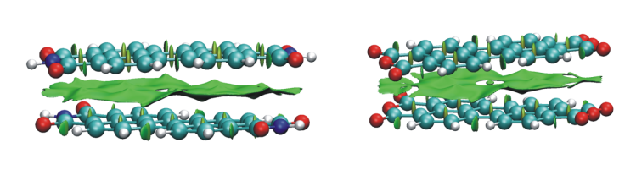
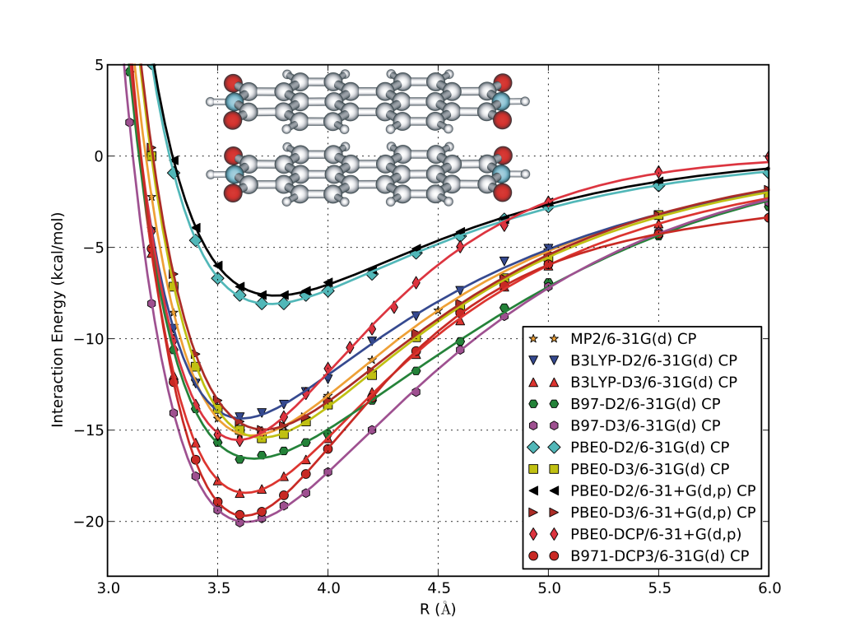
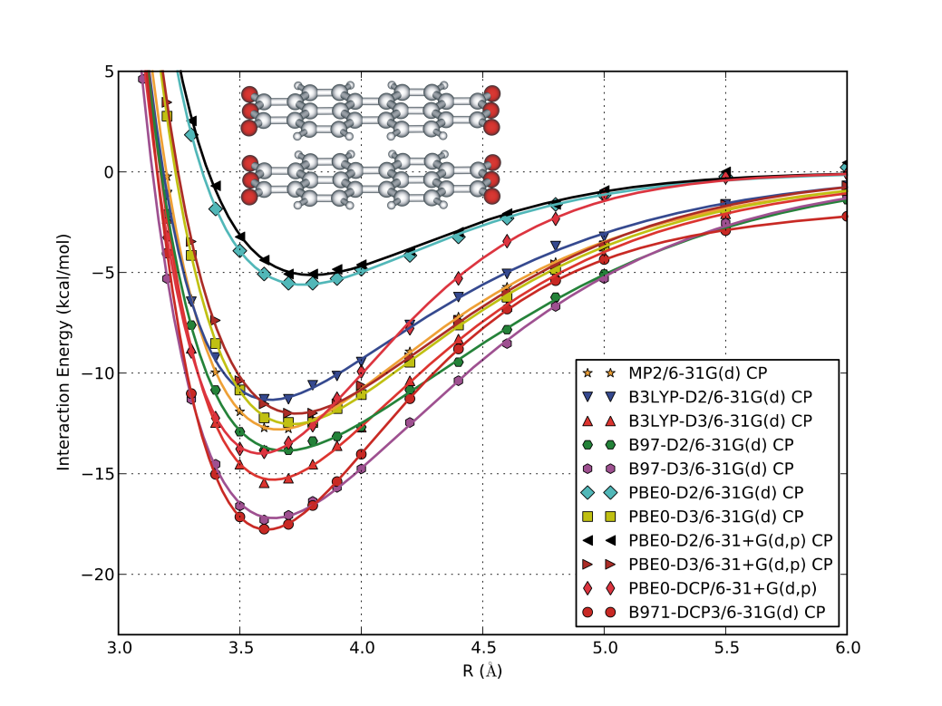
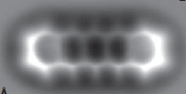
DFT-D
Vasile Chiș
Why Computing Molecules?
Vasile Chiș
Modeling non-covalent interactions and molecular excited states by DFT methods
DFT-D
dyes
electronic and optoelectronic devices (FET, OLEDS, PCs)
engineering of two-dimensional porous nanostructures
building blocks sophisticated supramolecular architectures
dyes
electronic and optoelectronic devices (FET, OLEDS, PCs)
engineering of two-dimensional porous nanostructures
building blocks sophisticated supramolecular architectures
PTCDI and PTCDA
PTCDI and PTCDA
Potential energy curves
Potential energy curves
WhyPECs? L. Gross, F. Mohn, N. Moll, P. Liljeroth and G. Meyer, Science, 2009, 325, 1110.
WhyPECs? L. Gross, F. Mohn, N. Moll, P. Liljeroth and G. Meyer, Science, 2009, 325, 1110.
PBE0-D2 – much less binding than the other methos
B97-D3 and B971-DCP3 -> overbinding
No BSSE correction for PBE0-DCP method
PBE0-D2 – much less binding than the other methos
B97-D3 and B971-DCP3 -> overbinding
No BSSE correction for PBE0-DCP method

Slide 22
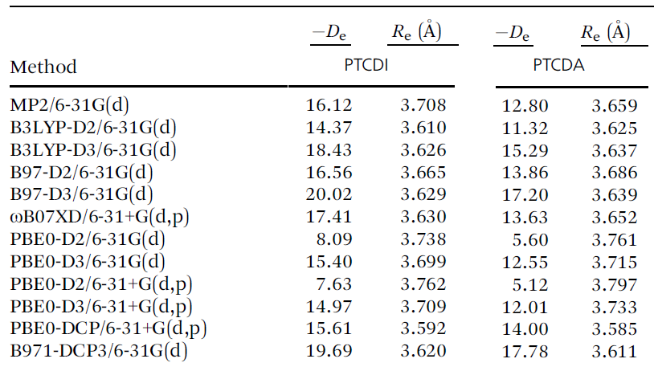
DFT-D
Vasile Chiș
Why Computing Molecules?
PTCDI and PTCDA
Potential energy curves
Calculated binding energies (in kcal mol1) and equilibrium intermolecular distances (in Å) for the stacked PTCDI and PTCDA dimers at different levels of theory
Comparison with other data available for PTCDI:
H dimer
RI-BLYP-D/TZV(P): De=-16.00kcal/mol
(Fink et al., JACS, 2008, 130, 12858)
Fully optimized PTCDI dimer
PBE0-DCP/BS2: De=-29.84 kcal/mol
(this work)
SCS-MP2/QZV)): De=-32.65 kcal/mol
(Zhao et al., JACS, 2009,131, 15660)
M. Oltean, G. Mile, M. Vidrighin, N. Leopold, V. Chis,
Phys. Chem. Chem. Phys., 15 (2013) 13978-13990

Slide 23
DFT-D
Vasile Chiș
Why Computing Molecules?
PTCDI and PTCDA
Potential energy curves
Facts:
1. MP2/BS1 (BSSE corrected) provides surprisingly good results
2. MP2/small basis set without BSSE correction– strongly overbinds
two counter-competing effects:
overbinding inherent to MP2
underestimation of BE due to low molecular polarizability inherent to small basis sets
Supplementary data
MP2/aug(d)-6-31G(d)
SCS-MP2/aug(d)-6-31G(d)
SCS-MP2/cc-pVTZ
PBE0-DCP/6-31+G(d,p) approach
Pragmatic and computationally efficient quantum chemical method for PECs and PESs of large dimers such as PTCDI and PTCDA (BSSE correction is avoided)
convergence is clearly observed for the binding energies derived by the three complementary methods used in this work (CP-MP2, DFT-D and DFT-DCP)

Slide 24

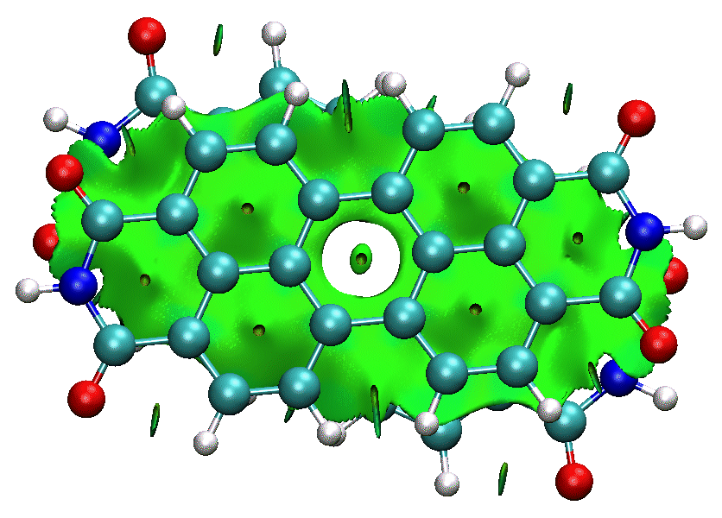
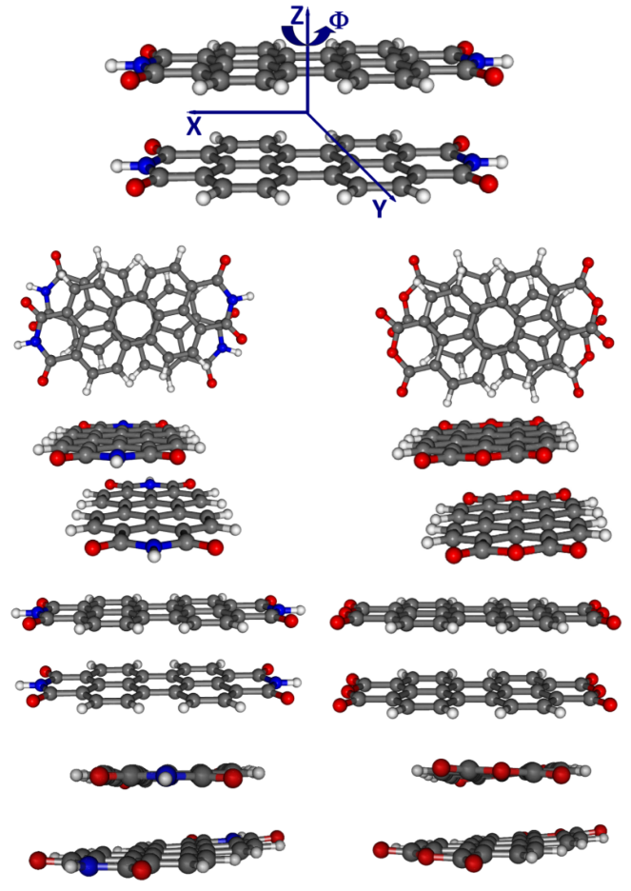
DFT-D
Vasile Chiș
Why Computing Molecules?
PTCDI and PTCDA
Partially and fully optimized structures of PTCDI and PTCDA
J₁
J₂
H
FullOpt

Slide 25
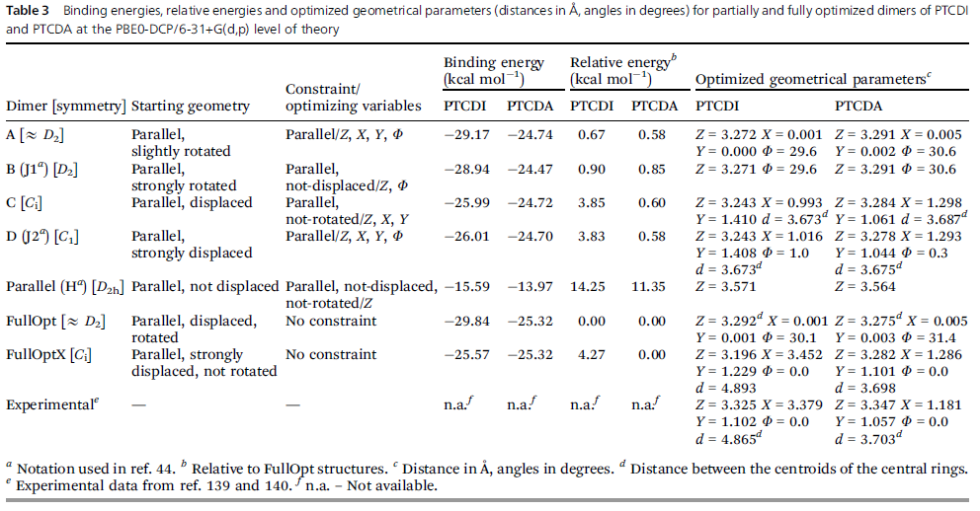

DFT-D
Vasile Chiș
Modeling non-covalent interactions and molecular excited states by DFT methods
PESs of PTCDI and PTCDA
M. Oltean, G.S. Mile, M. Vidrighin, N. Leopold, V. Chiş,
Phys. Chem. Chem. Phys., 15 (2013) 13978-13990

Slide 26
DFT-D
Vasile Chiș
Modeling non-covalent interactions and molecular excited states by DFT methods
PESs of PTCDI and PTCDA
2 polymorphic forms for PTCDA,
1 for PTCDI
M. Oltean, G.S. Mile, M. Vidrighin, N. Leopold, V. Chiş,
Phys. Chem. Chem. Phys., 15 (2013) 13978-13990

Slide 27
DFT-D
Vasile Chiș
Modeling non-covalent interactions and molecular excited states by DFT methods
PESs of PTCDI and PTCDA
Flat PES for FullOpt dimers of PTCDA
J1 dimers are more stable than J2-type; H dimers are the least stable
Qualitative and quantitative agreement with experimental geometrical parameters
J₁
J₂
H
FullOpt
M. Oltean, G.S. Mile, M. Vidrighin, N. Leopold, V. Chiş,
Phys. Chem. Chem. Phys., 15 (2013) 13978-13990

Slide 28
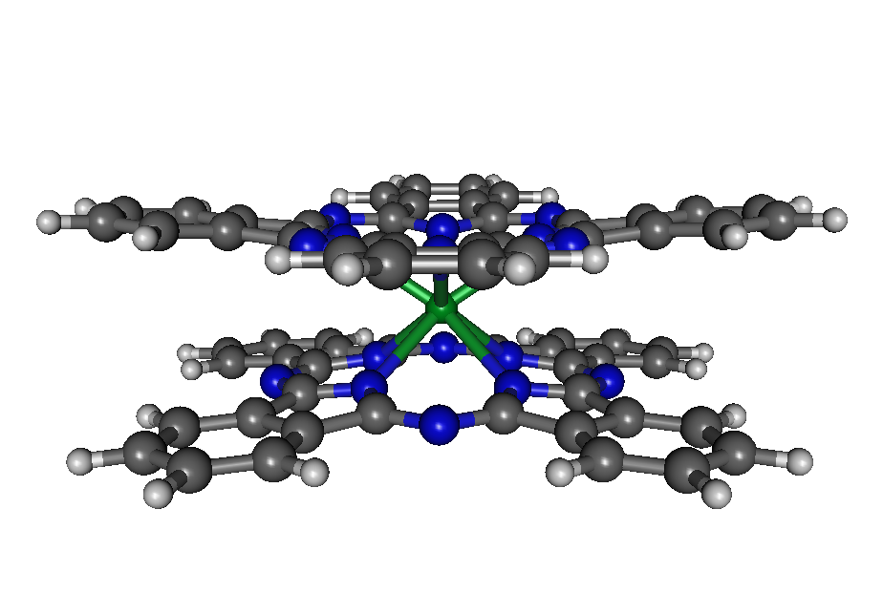
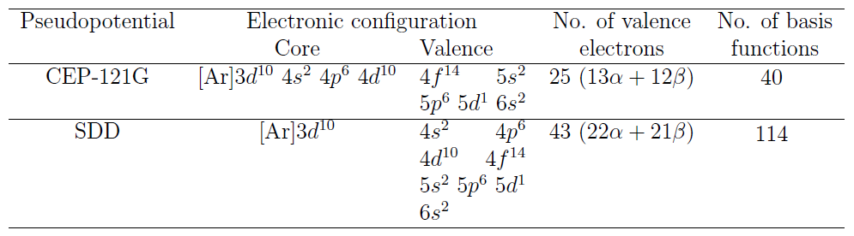
DFT-D
Vasile Chiș
Why Computing Molecules?
LuPc₂ complex
the first reported molecular semiconductor
suitable candidate for applications in the field of nanoelectronics
    conductive and electrochromic properties (reversibly changing color when a burst of charge is applied)
    intrinsic conductivity which is about seven orders of magnitude larger than in case of other organic semiconductors
Aims
Influence of dispersion on (inter-rings) geometrical parameters
Test the performance of SDD and CEP ECPs for predicting geometrical parameters

Slide 29
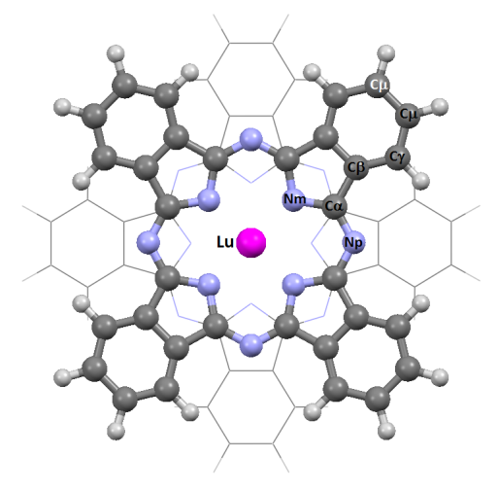
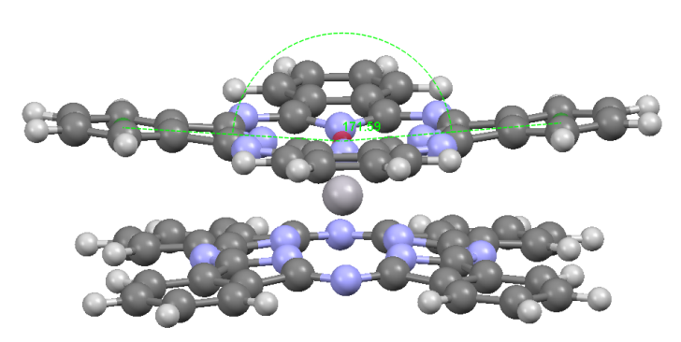
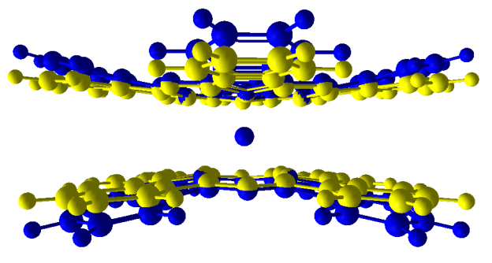
DFT-D
Vasile Chiș
Why Computing Molecules?
LuPc₂ complex
Bond | B971-DCP SDD | B3LYP SDD | B971-DCP CEP | B3LYP CEP | Exp.*
C_{phα} - C_{phα} | 1.418 | 1.406 | 1.418 | 1.406 | 1.389
C_{β} - C_{β} | 1.417 | 1.404 | 1.418 | 1.405 | 1.390
C_{α} - C_{β} | 1.480 | 1.467 | 1.480 | 1.467 | 1.456
N_{iso} - C_{α} | 1.377 | 1.371 | 1.377 | 1.371 | 1.376
N_{m} - C_{α} | 1.335 | 1.330 | 1.336 | 1.330 | 1.327
Lu - Niso | 2.396 | 2.413 | 2.414 | 2.432 | 2.342
Pc -Pc | 2.706 | 2.730 | 2.746 | 2.778 | 2.691
Doming | 171.6 | 161.9 | 180.0 | 180.0 | -
 | *M. Moussavi, A. De Cian, J. Fischer, R. Weiss, Inorg. Chem., 27 (1988), 1287
Intra-ring parameters
  both functional and ECPs perform well
Inter-ring:
  dispersion is mandatory
  SDD provides better results than CEP-121G
Raman spectra well reproduced by B971-DCP approach
Go for TmPc₂ and EuPc₂ complexes
  vibrational and electronic spectra

Slide 30
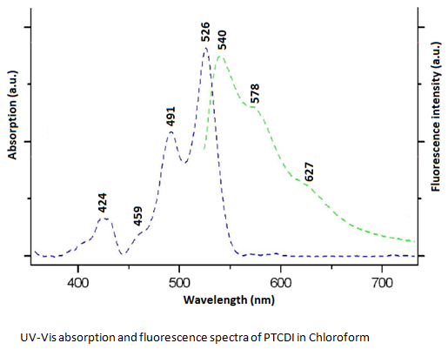
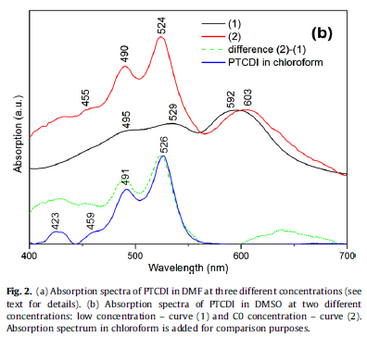
TD-DFT
Vasile Chiș
Why Computing Molecules?
Monomers;
vibronic structure
490-529 nm)
Electronic absorption spectra of PTCDI
Aggregates
(dimers) (592-603 nm)
No signature of the aggregated PTCDI molecules was observed in chloroform
Formation of PTCDI aggregates ->absorption band at 592 and 598 nm, in DMF and DMSO solvents
M. Oltean, A. Calborean, G. Mile, M. Vidrighin, M. Iosin , L. Leopold, D. Maniu, N. Leopold, V. Chis, Spectrochim. Acta A, 97 (2012) 703–710

Slide 31
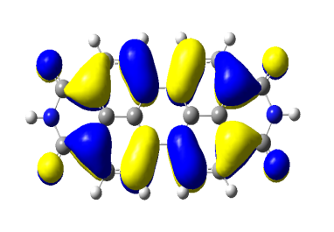
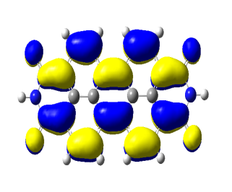
TD-DFT
Vasile Chiș
Why Computing Molecules?
Electronic absorption spectra
Calculated absorption spectra of PTCDI
No. | Configuration | E(nm) | f
PTCDI monomer (DMF)
1 | HOMO→LUMO (98%) | 537.3 | 0.864
2 | HOMO-2 →LUMO (90%) | 346.3 | 0.127
3 | HOMO→LUMO+4 (90%) | 283.6 | 0.067
PTCDI dimer (DMF)
2 | HOMO→LUMO+2 (54%) | 598.0 | 0.003
HOMO (left) and LUMO (right) of PTCDI
M. Oltean, A. Calborean, G. Mile, M. Vidrighin, M. Iosin , L. Leopold, D. Maniu, N. Leopold, V. Chiș, Spectrochim. Acta A, 97 (2012) 703–710

Slide 32
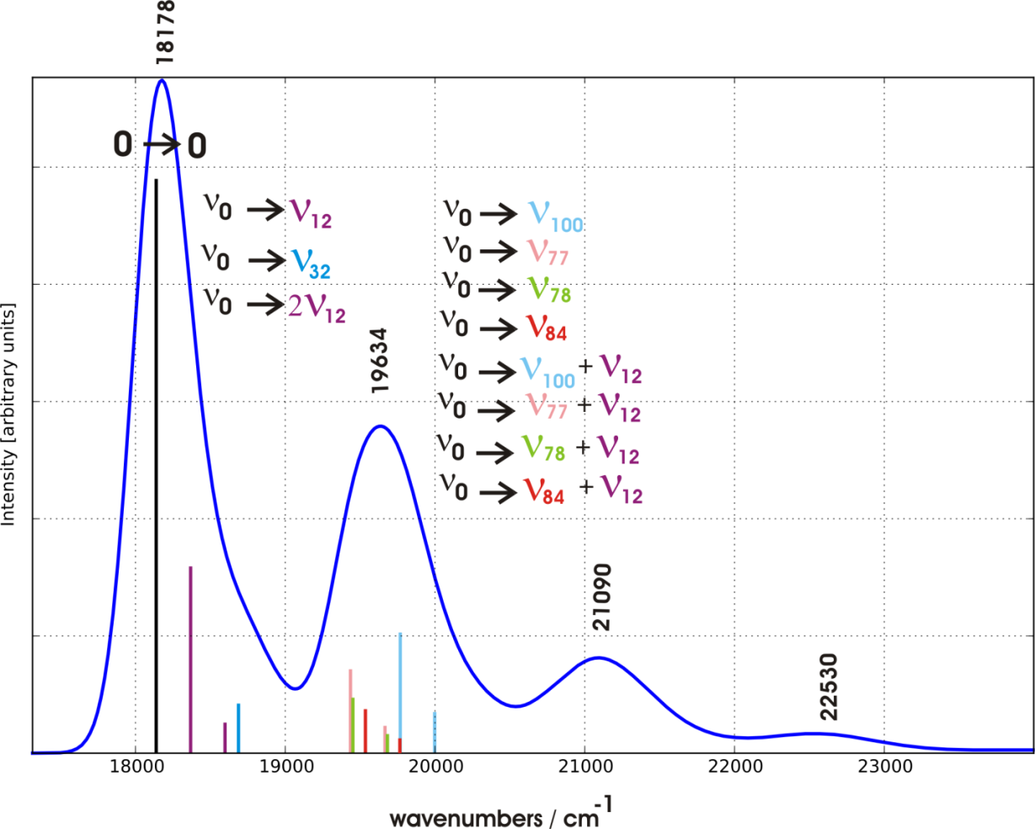
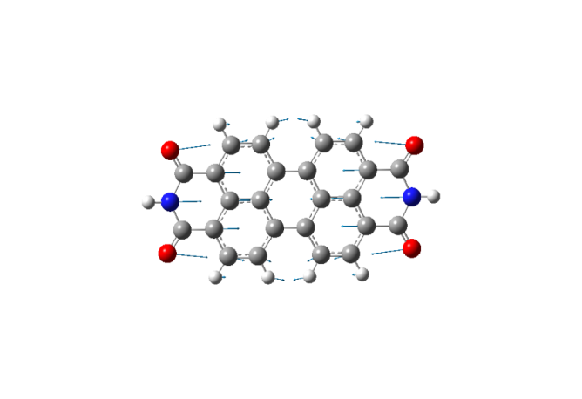
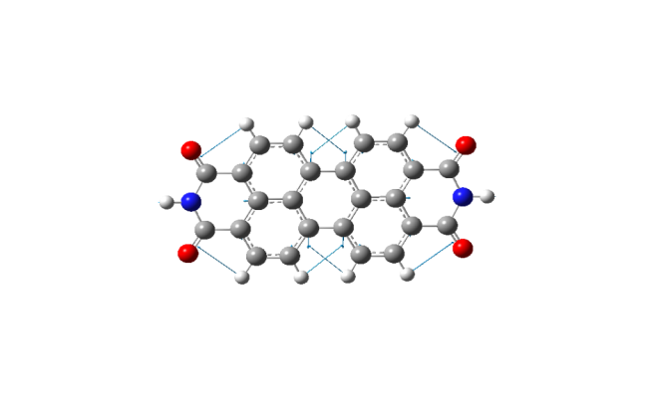
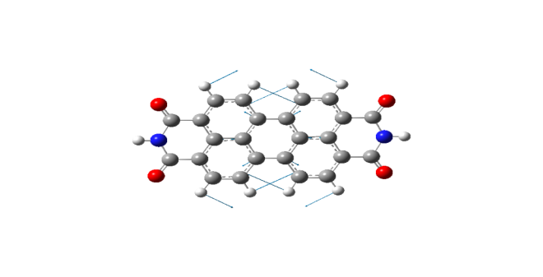
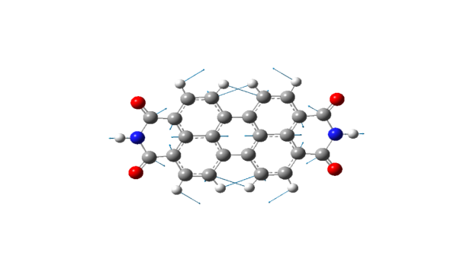
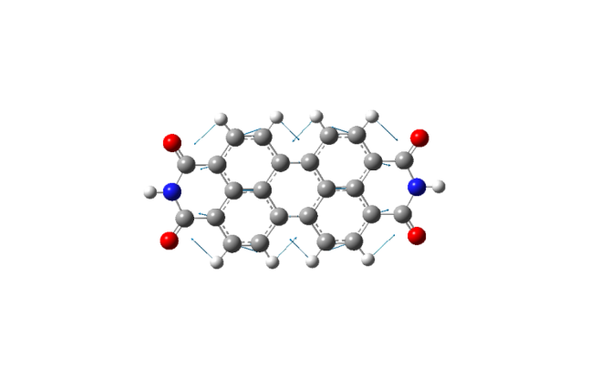
TD-DFT
Vasile Chiș
Why Computing Molecules?
Vibronic structure of the absorption spectrum of PTCDI
ν₁₂: 230 cm⁻¹
ν₇₇: 1262 cm⁻¹
ν₇₈: 1279 cm⁻¹
ν₈₄: 1342 cm⁻¹
PBE0-DCP/6-31+G(d,p) calculated absorption spectrum of PTCDI monomer in gas phase (excitation to the first electronic excited state). The stick lines refer to the individual vibronic transitions (the lengths of the bars indicate the oscillator strength).
ν₁₀₀: 1587 cm⁻¹
M. Oltean, A. Calborean, G. Mile, M. Vidrighin, M. Iosin , L. Leopold, D. Maniu, N. Leopold, V. Chiș, Spectrochim. Acta A, 97 (2012) 703–710

Slide 33
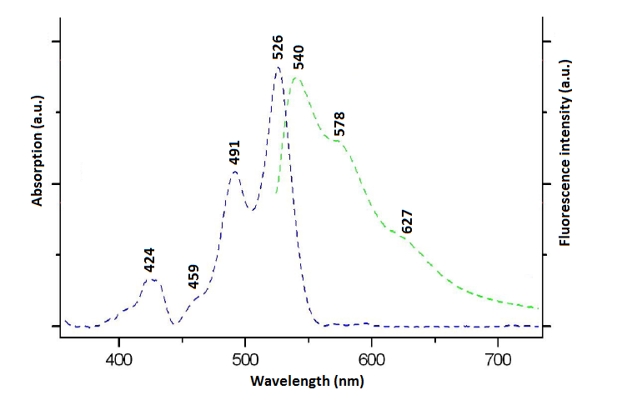
TD-DFT
Vasile Chiș
Why Computing Molecules?
Vibronic structure of the absorption spectrum of PTCDI
PBE0-DCP/6-31+G(d,p) simulation of the absorption and emission vibronic spectra of PTCDI in gas phase
UV-Vis absorption (blue line) and fluorescence (green line) spectra of PTCDI in Chloroform
M. Oltean, A. Calborean, G. Mile, M. Vidrighin, M. Iosin , L. Leopold, D. Maniu, N. Leopold, V. Chis, Spectrochim. Acta A, 97 (2012) 703–710

Slide 34

TD-DFT
Vasile Chiș
Why Computing Molecules?
Excited state geometry of PTCDI
Optimized geometrical parameters for the ground state (bottom) and first excited state (top) of PTCDI in gas phase at PBE0-DCP/6-31+G(d,p) level of theory.
M. Oltean, A. Calborean, G. Mile, M. Vidrighin, M. Iosin , L. Leopold, D. Maniu, N. Leopold, V. Chis, Spectrochim. Acta A, 97 (2012) 703–710

Slide 35

Absorption spectrum if imatinib
Vasile Chiș
Why Computing Molecules?
used in the treatment of chronic myelogenous leukemia and gastrointestinal stromal tumors
conformational changes of IMT are crucial for understanding the ligand-receptor interaction and its mechanism of action
of interest if the lowest energy conformer of the free molecule resembles the 3D structure of the bioactive conformations found in different ligand-receptor
IMT crystallize in two polymorphic forms, α and β, with triclinic P-1 symmetry
Conformational study
Optimized molecular structures of the most stable conformer of imatinib (IMT) in water at B3LYP/6-31+G(d,p) level of theory, with the atom numbering scheme
Conformational landscape and low lying excited states of imatinib,
Emil Vinţeler, Nicoleta-Florina Stan, Raluca Luchian, Călin Căinap, João P. Prates-Ramalho, Vasile Chiş,
Journal of Molecular Modeling, 2015, 21, 84

Slide 36
Absorption spectrum if imatinib
Vasile Chiș
Why Computing Molecules?
Molecule: | imatinib
Method: | B3LYP/6-31+G(d,p)
Solvent: | water
Conformer | dG (kcal/mol) | Boltzmann factor | Population (%)
5 | 0.00 | 1.000 | 11.13%
16 | 0.03 | 0.955 | 10.63%
13 | 0.03 | 0.951 | 10.59%
6 | 0.26 | 0.649 | 7.22%
3 | 0.27 | 0.635 | 7.07%
7 | 0.34 | 0.565 | 6.29%
10 | 0.41 | 0.501 | 5.57%
18 | 0.49 | 0.437 | 4.86%
14 | 0.49 | 0.435 | 4.84%
>700 conformers at MM level
45 conformers within 4.8 kcal/mol at
B3LYP/BS1 level of theory
9 conformers within 0.6 kcal/mol
conformers derived from the X-ray spans the 0.3 – 4 kcal/mol
different energetic order in gas-phase and water
The major difference between the most stable free conformers and the bioactive conformers consists in the relative orientation of the pyrimidine-pyridine groups responsible for the hydrogen bonding interactions in the ATP binding pocket
6-31G(d) is enough for geometry optimization
6-31+G(d,p) recommended for relative energy calculations

Slide 37
Absorption spectrum if imatinib
Vasile Chiș
Why Computing Molecules?
B3LYP/6-31G(d), water
cam-B3LYP/6-31+G(d,p), water
Conformational landscape and low lying excited states of imatinib,
Emil Vinţeler, Nicoleta-Florina Stan, Raluca Luchian, Călin Căinap, João P. Prates-Ramalho, Vasile Chiş,
Journal of Molecular Modeling, 2015, 21, 84

Slide 38

Absorption spectrum if imatinib
Vasile Chiș
Why Computing Molecules?
important charge transfer character
=> need for range-separated functionals (cam-B3LYP)
Conformational landscape and low lying excited states of imatinib,
Emil Vinţeler, Nicoleta-Florina Stan, Raluca Luchian, Călin Căinap, João P. Prates-Ramalho, Vasile Chiş,
Journal of Molecular Modeling, 2015, 21, 84

Slide 39








TD-DFT
Vasile Chiș
Why Computing Molecules?
Electronic absorption spectra of Dacarbazine
DCB – computational models
Monomers:
m1_cx
m1_c2
m2_cx
m1_c2_t2
Dimers:
dimx
dimHB1
dimHB2
dimStack
M. Chiş, C. Căinap, A. Găbudean, M. Focşan, N. Leopold, V. Chiş
Manuscript in preparation

Slide 40







TD-DFT
Vasile Chiș
Why Computing Molecules?
Electronic absorption spectra of Dacarbazine
DCB monomers – what’s their energetic order?
Relative energies (ΔE_{HF} – light color, ΔG – dark color) of the DTIC monomers calculated at B3LYP/6-31+G(2d,2p) level of theory, in gas (grey) and water (blue)
Conformer | m2_cx | m1_cx | m1_c2 | m1_c3 | m2_c2 | m2_c3 | m1_c2_t2
Relative Gibbs free energy in water (kcal/mol) | 0.00 | 0.88 | 0.88 | 4.5 | 6.51 | 8.09 | 55.02
Boltzmann population at RT (%) | 69.14 | 15.41 | 15.41 | 0.03 | 0.00 | 0.00 | 0.00

Slide 41

TD-DFT
Vasile Chiș
Why Computing Molecules?
Electronic absorption spectra of Dacarbazine
DCB – UV-Vis spectrum
328 nm: S0-> S1 transition
236 nm: S0 -> S2 transition
B3LYP/6-31+G(2d,2p) Gas-phase
System | λ (nm) | f | Transitions | Contributions
m2_cx | 298 | 0.53 | H-L | 98%
 | 233 | 0.11 | H-4-L | 61%
 | 228 | 0.18 | H-3-L | 40%
B3LYP/6-31+G(2d,2p) Water
System | λ (nm) | f | Transitions | Contributions
m2_cx | 310 | 0.62 | H-L | 99%
 | 232 | 0.28 | H-3-L | 79%
m1_cx | 323 | 0.61 | H-L | 90%
 | 224 | 0.20 | H-4-L | 73%
m1_c2 | 320 | 0.68 | H-L | 99%
 | 224 | 0.18 | H-4-L | 76%
UV-Vis absorption spectrum of Dacarbazine in water

Slide 42






TD-DFT
Vasile Chiș
Why Computing Molecules?
Electronic absorption spectra of Dacarbazine
HOMO-LUMO gap
284 nm (gas-phase)
290 nm (water)
TD-DFT
298 nm (gas-phase)
310 nm (water)
Conformer contributions
averaged by the Boltzmann populations
314 nm (water)
328 nm – Experimental
HOMO
LUMO
HOMO-4

Slide 43




TD-DFT
Vasile Chiș
Why Computing Molecules?
Electronic absorption spectra of Dacarbazine
DCB – UV-Vis spectrum – pH dependence
a new excitated state is active for electronic transition at high pH
both peaks suffer a red shift by increasing pH
the bathochromic shift is due to the presence of different species at different pH values:
protonated at low pH
neutral at medium pH
deprotonated species at high pH
m2 species of dacarbazine found at different pH values:
a) protonated; b) neutral; c) deprotonated

Slide 44
TD-DFT
Vasile Chiș
Why Computing Molecules?
Electronic absorption spectra of Dacarbazine
DCB – UV-Vis spectrum – pH dependence
Deprotonated
Protonated
Calculations reproduce not anly the shifts of the transitions but also their relative intensities

Slide 45


TD-DFT
Vasile Chiș
Why Computing Molecules?
Electronic absorption spectra of Dacarbazine
DCB – excited state geometry
m2_cx gas phase
m2_cx - water
- excited state
m2_cx tautomer becomes non-planar in the first allowed excited state
      dihedral angle C2N10N11N12 change from 180.0º to 96.9º
C4-N9 bond decreases by 0.019 Å
important changes in the C2-C3 (+0.032 Å), C2N10 (-0.078 Å), N10-N11 (+0.094 Å) and N11-N12 (+0.029 Å) bonds

Slide 46







TD-DFT
Vasile Chiș
Modeling non-covalent interactions and molecular excited states by DFT methods
Fluorescence lifetimes
Time‐Resolved Fluorescence Technical Note TRFT‐1
Time‐resolved fluorescence lifetime measurements

Slide 47



TD-DFT
Vasile Chiș
Modeling non-covalent interactions and molecular excited states by DFT methods
Fluorescence lifetimes
=E(TD-KS)_{GS} => from TD on GS
=E(TD-KS)_{ES} => from Opt on ES
=> from Opt on ES
=E_{GS} => from Opt on GS

Slide 48



TD-DFT
Vasile Chiș
Why Computing Molecules?
Fluorescence lifetimes
Test case: 5-Carboxy-X-rhodamine
http://www.fluorophores.tugraz.at/substance/608
 | Experimental data | Calculated data
E_{abs}(eV) | 2.15 | 2.470
E_{em}(eV) | 2.08 | 2.087
τ_{exp} (ns) | 2.18 | -
τ_{r} (ns) | n.a. | 5.550
τ_{nr} (ns) | n.a. | -
Φ(%) | n.a. | -
5Rox – S₀ optimized geometry
5Rox – S₁ optimized geometry

Slide 49

TD-DFT
Vasile Chiș
Modeling non-covalent interactions and molecular excited states by DFT methods
Fluorescence lifetimes
Perylene | Experimental data | Calculated data B3LYP | Calculated data M06-2X
E_{abs}(nm) | 409 (chx) 417 (acn) | BS2: 462 (chx, D2) BS3: 448 (gas, NoD); 462 (chx, NoD) | BS1: 386 (chx, NoD) BS2: 402 (chx, NoD) BS4: 393 (chx, NoD)
E_{em}(nm) | 464 (chx) | BS2: 526 (chx, D2) BS3: 507 (gas, NoD); 528 (chx, NoD) | BS1: 458 (chx, NoD) BS2: 480 (chx, NoD) BS4: 472 (chx, NoD)
E₀₋₀(nm) | 438 (chx) (449 (acn) | BS3: 491 (gas, NoD)
τ_{exp} (ns) | 6.4 | - | -
τ_{r} (ns) | 6.88 | BS2: 8.71 (chx, D2) BS3: 11.49 (gas, NoD); 9.43 (chx, NoD) | BS1: 5.48 (chx, NoD) BS2: 6.21 (chx, NoD) BS4: 6.01 (chx, NoD)
τ_{nr} (ns) | n.a. | - | -
Φ(%) | 93 (chx) | - | -
Symmetries:
D2h, D2, C2
BS1: 6-31G(d)
BS2: 6-31+G(d,p)
BS3: 6-31+G(2d,2p)
BS4: 6-311G(d,p)
Conclusions:
Dispersion: not important (intra)
Solvent: important
Functional: important
Basis set: important

Slide 50

TD-DFT
Vasile Chiș
Modeling non-covalent interactions and molecular excited states by DFT methods
Fluorescence lifetimes
PTCDI
 | τ₁ | A₁ (%) | τ₂ | A₂ (%) | χ²
CHCl3 | 3.58 | 100 | - | - | 1.024
DMF | 3.58 (fixed) | 86.1 | 1.55 | 13.9 | 0.985
DMSO | 3.58 (fixed) | 4.8 | 1.12 | 95.2 | 1.034

Slide 51

TD-DFT
Vasile Chiș
Modeling non-covalent interactions and molecular excited states by DFT methods
Fluorescence lifetimes
PTCDI | Exp. data in CHCl3 | Calculated data B3LYP | Calculated data M06-2X | Calculated data PBE0
E_{abs}(nm) | 493 | 523 (gas, D2) 557 (CHCl3, NoD) 557 (CHCl3, D2) | 471 (CHCl3, NoD) 472 (DMSO, NoD) 469 (CYHA, NoD) | 507 (gas, DCP)
E_{em}(nm) | 575 | 577 (gas, D2) 652 (CHCl3, NoD) 653 (CHCl3, D2) | 585 (CHCl3, NoD) 613 (DMSO, NoD) 554 (CYHA), NoD) | 564 (Gas, DCP)
τ_{exp} (ns) | 3.58 | - | - | -
τ_{r} (ns) | - | 8.10 (gas, D2) 6.70 (CHCl3, NoD) 6.73 (CHCl3, D2) | 4.88 (CHCl3, NoD) 4.84 (DMSO, NoD) 5.07 (CYHA, NoD) | 7.48 (gas, DCP)
τ_{nr} (ns) | - | - | -
Φ(%) | - | - | -
Symmetries: D2h, D2, C2, C1
BS2: 6-31+G(d,p)
Solvents: CHCl3, DMSO, CYHA
Conclusions:
Dispersion: not important (intra)
Solvent: important
Functional: important
Basis set: not tested

Slide 52
TD-DFT
Vasile Chiș
Why Computing Molecules?
Dacarbazine – fluorescence lifetimes
τ(ns) | <A> (%)
0.62 | 64.60
1.27 | 30.05
4.62 | 4.90
3 species (?)
m2
m1
dimer
(Calculations in progress)
Time-resolved fluorescence at of 0.8⋅10⁻² M aqueous solution dacarbazine
excitation: 375 nm
laser power 28.3 µW)

Slide 53
TD-DFT
Vasile Chiș
Why Computing Molecules?
Algorithm for excited states calculations
Electronic absorption spectra
Optimize the ground state and calculate the frequencies.
Check if the geometry corresponds to a minimum on the PES
Calculate the excitation energies
%chk=LEV_OFR.chk
%mem=32GB
%nprocshared=32
#P TD(nstates=30) b3lyp/6-31+g(2d,2p) scrf=(pcm, solvent=water)
PTCDI TD water
0 1
C ...................
.....
Optimized geometry in step 1
.....
Excitation energies and oscillator strengths: Excited State 1: Singlet-A 4.1537 eV 298.49 nm f=0.0891 <S**2>=0.000 121 ->132 0.11358
126 ->132 -0.12486
128 ->132 0.17390
129 ->132 0.17002
131 ->132 0.60413
131 ->135 -0.10425
Total Energy, E(TD-HF/TD-KS) = -1581.40003448
HF=-1581.5526807
=> dE=4.1537 eV

Slide 54
Acknowledgements
Vasile Chiș
Why Computing Molecules?
UBB
Dr. Nicolae Leopold
Dr. Simona Cîntă Pînzaru
Dr. Dana Maniu
Dr. Emil Vințeler
Dr. Mircea Oltean
Dr. Szabó László
Dr. Alexandra Falamaș
Dr. George Mile
Dr. Nicoleta Mircescu
Dr. Radu Isai
Drd. Raluca Luchian
Drd. Tódor István
Drd. Simon Botond
Mast. Ana Gherman
Mast. Mihaela Chiș
Ex-students
Drd. Iulia Brumboiu - Uppsala, Sweden
Drd. Eric Meheș - Trinity College, Dublin
Drd. Mihai Vidrighin - Oxford, UK
Drd. Alexandra Bălăceanu - IRB Barcelona, Spain
ICEI
Dr. Ana Găbudean
Dr. Monica Iosin
Photon Cluster
Dr. Sándor Borbély
Projects
Nanobiofun - CNCSIS–UEFISCSU, project number PNII-ID_PCCE_129/2008
PN II – Capacities – project title Integrated Network for Interdisciplinary Research – INIR
COST Action CM1002 - CODECS: COnvergent Distributed Environment for Computational Spectroscopy

